Slide 1

Cyber Security By Elysium Academy
Protecting the Digital World

Slide 2

What is Cyber Security ?
Protection of computers, networks, systems, and data from unauthorized access.
Prevents theft, damage, and disruption.
Essential for individuals , businesses , and governments.

Slide 3

Why Cyber Security Matters
Protects sensitive information. Prevents financial losses. Maintains customer trust. Ensures business continuity. Supports legal and regulatory compliance.

Slide 4
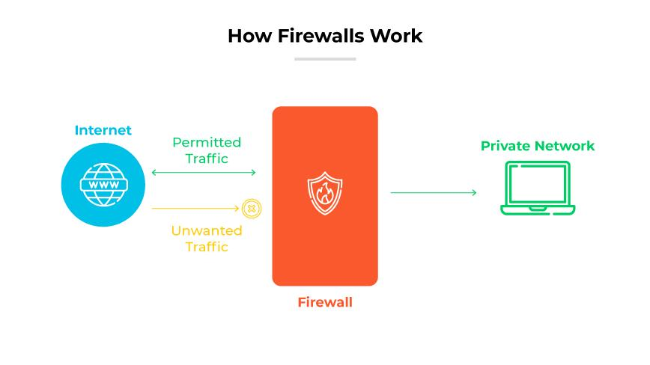
Cyber Security Goals
CIA Triad
Confidentiality
Integrity
Availability

Slide 5

Evolution of Cyber Security
Early computer security Internet era challenges Mobile and cloud security AI-driven security solutions

Slide 6

Types of Cyber Security
Network Security Application Security Information Security Cloud Security Mobile Security Identity Security

Slide 7
Basic Cyber Security Terms
Malware
Virus
Worm
Trojan Horse
Firewall
Encryption
Authentication

Slide 8
Understanding Cyber Threats
Internal threats
External threats
Human errors
Advanced persistent threats

Slide 9
Malware
Malicious Software
Viruses
Worms
Trojans
Spyware
Adware

Slide 10
Ransomware
Encrypts files
Demands payment
Can halt business operations
Growing global threat

Slide 11
Phishing Attacks
Fake emails
Fraudulent websites
Credential theft
Social engineering techniques

Slide 12
Social Engineering
Manipulating people
Impersonation
Baiting
Pretexting

Slide 13
Password Attacks
Brute Force
Dictionary Attacks
Credential Stuffing
Password Spraying

Slide 14
Network Security Basics
Secure communication
Threat detection
Traffic monitoring
Access control

Slide 15
Firewalls
First Line of Defense
Monitors network traffic
Blocks unauthorized access
Filters malicious activities

Slide 16
Network Attacks
Denial of Service (DoS)
Distributed DoS
Man-in-the-Middle
Packet Sniffing

Slide 17
Wi-Fi Security
Secure Wi-Fi configuration
WPA 2 / WPA 3
Strong passwords
Avoid public network risks

Slide 18
Web Application Security
SQL Injection
Cross-Site Scripting (XSS)
Session Hijacking

Slide 19
Authentication & Authorization
Access Management
User Verification
Permissions Control
Role-Based Access

Slide 20
Multi-Factor Authentication (MFA)
Password
OTP
Biometrics
Security Keys

Slide 21
Cryptography
Protecting Information
Encryption
Decryption
Symmetric Encryption
Asymmetric Encryption

Slide 22
VPN (Virtual Private Network)
Secure internet communication
Data privacy
Remote access protection

Slide 23
Incident Response
Responding to Security Breaches
Identify
Contain
Eradicate
Recover
Review

Slide 24
Security Operations Center (SOC)
Continuous monitoring
Threat detection
Incident management
Security analytics

Slide 25
Cloud Security
Data protection
Secure cloud storage
Access management
Cloud risk mitigation

Slide 26
Cyber Security Policies
Acceptable use policy
Password policy
Data protection policy
Incident handling policy

Slide 27
Emerging Cyber Security Trends
Artificial Intelligence
Machine Learning
Zero Trust Security
Threat Intelligence

Slide 28
Career Opportunities
Security Analyst
Ethical Hacker
Penetration Tester
Security Engineer
Incident Responder
Security Consultant

Slide 29
Best Practices for Staying Safe
Use strong passwords
Enable MFA
Update software regularly
Avoid suspicious links
Backup important data

Slide 30
Thank You
Questions & Discussion
Quote: "Cyber Security is not a product, but a continuous process."
REFERENCES
notes Notes NOTES ( Notes 1 To Notes 6 ) - https://github.com/Narthana-Elysium
https://www.google.com/search?q=cyber+security+tutorial&rlz=1C1CHBD_enIN1039IN1039&oq=&gs_lcrp=EgZjaHJvbWUqCQgAECMYJxjqAjIJCAAQIxgnGOoCMgkIARAjGCcY6gIyCQgCECMYJxjqAjIJCAMQIxgnGOoCMgkIBBAjGCcY6gIyCQgFECMYJxjqAjIJCAYQIxgnGOoCMgkIBxAjGCcY6gLSAQg5MjdqMGoxNagCCLACAfEFYeaHxK1b6a0&sourceid=chrome&ie=UTF-8

